Slide 1







Data Analytics Bootcamp Group 1
Project 1

Slide 2




Corporate Member
Junnamdata was established circa 2024:
Jun Nam (Founder)
Rekha (Chief Data Officer)
Bailey (Senior Data Analyst)
Yau Shu Wong (Data Analyst)
“If you are shopping for common stocks, choose them the way you would buy groceries, not the way you would buy perfume.”
Jun
Notes:
20 seconds to introduce the team. Jun had a vision to revolutionize the data market during a trip to Bali.

Slide 3

Project Outline
Identify the correlations between various US macroeconomic indicators and US stock prices
Stock Profits vs Unemployment Rate
Stock Profits vs Federal Interest Rate
Stock Profits vs Bond Rate
Stock Profits vs Real GDP per Capita
Stock Profits vs CPI
Notes:
An executive summary or overview of the project and project goals:
Explain how the project relates to the industry you selected.

Slide 4
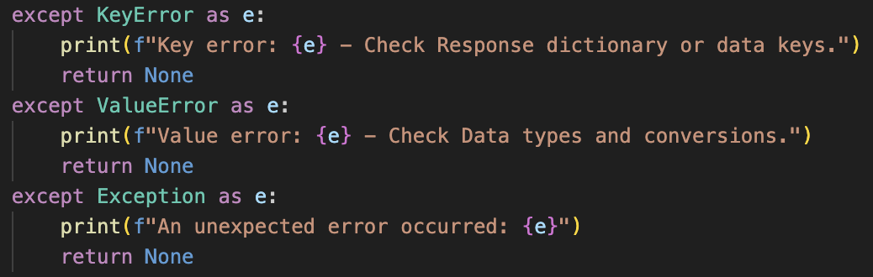
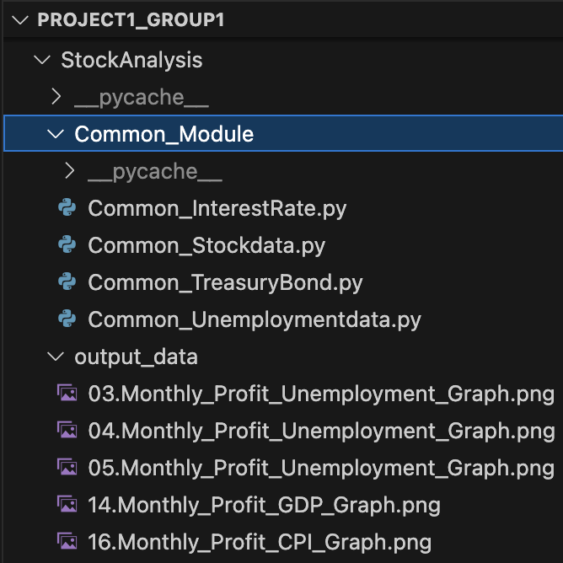
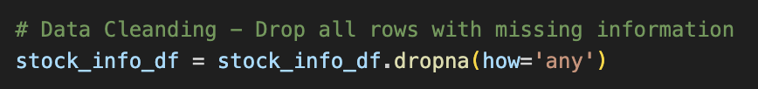
Data Collection, Cleanup, and Exploration Processes
Common module created to standardise data retrieving process
Selected time range ranges from 2010 to 2019 (pre-covid)
In general, the API data are of high quality. Applied ‘dropna’ to remove empty rows.
Applied exception handling for potential errors.
Notes:
Common module was created to centralise repetitive tasks.
Explain each module??? (time??)
An overview of the data collection, cleanup, and exploration processes:
Describe the source of your data and why you chose it for your project.
Describe the collection, exploration, and cleanup process.

Slide 5
API links

Slide 6
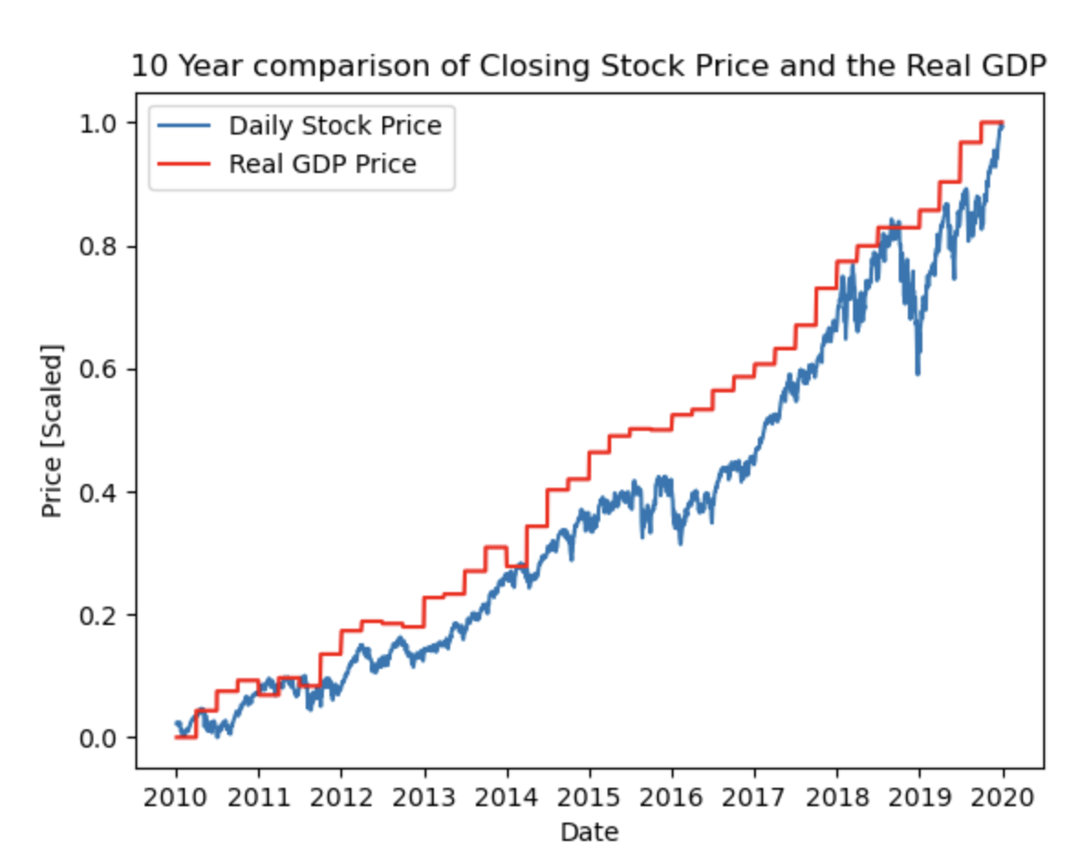
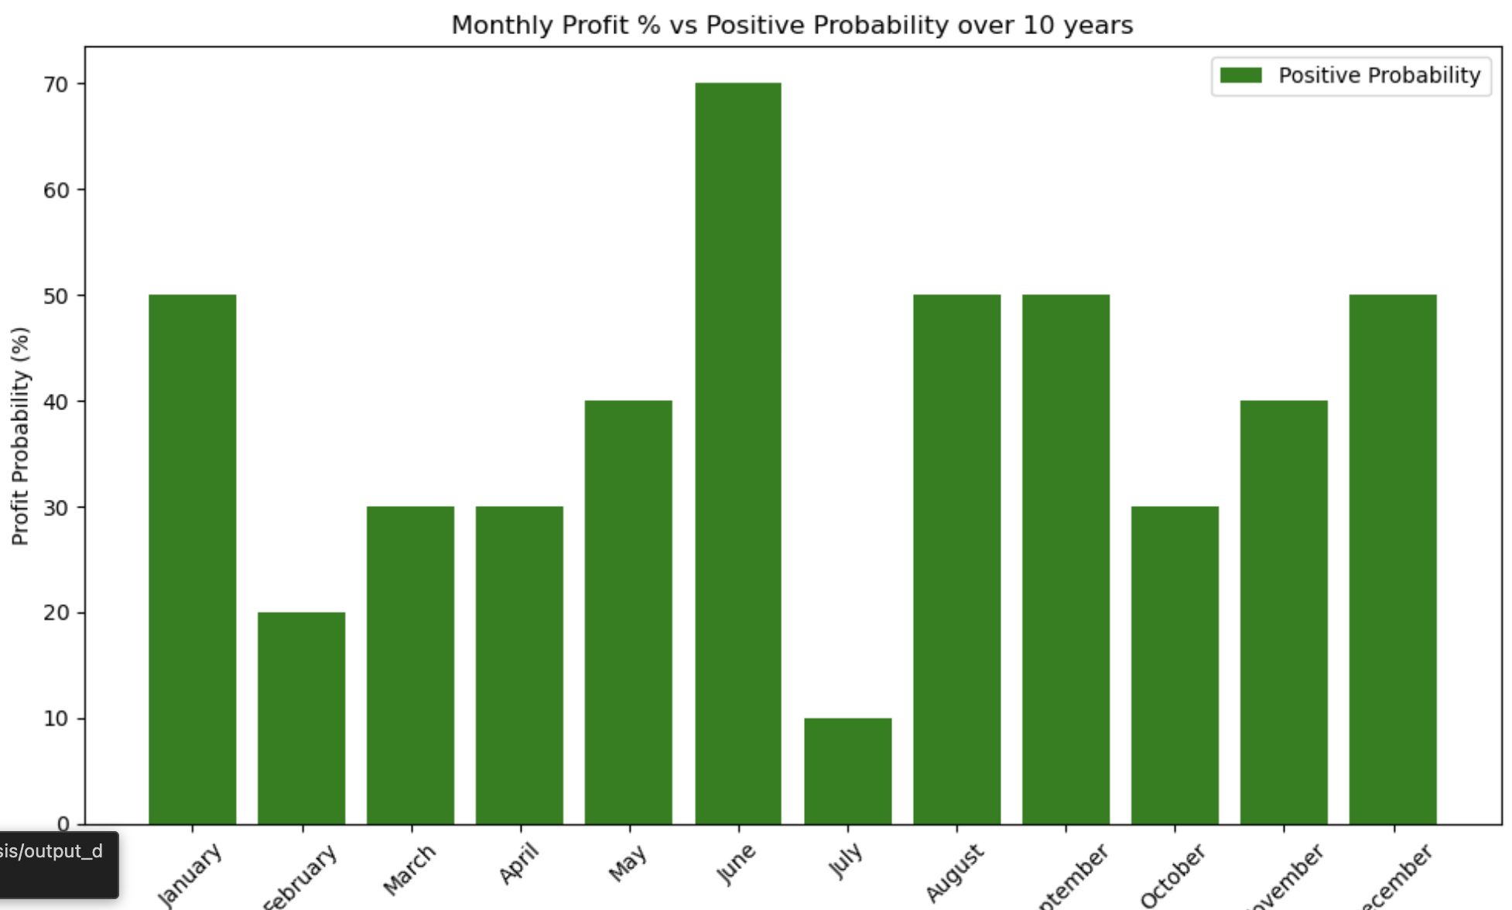
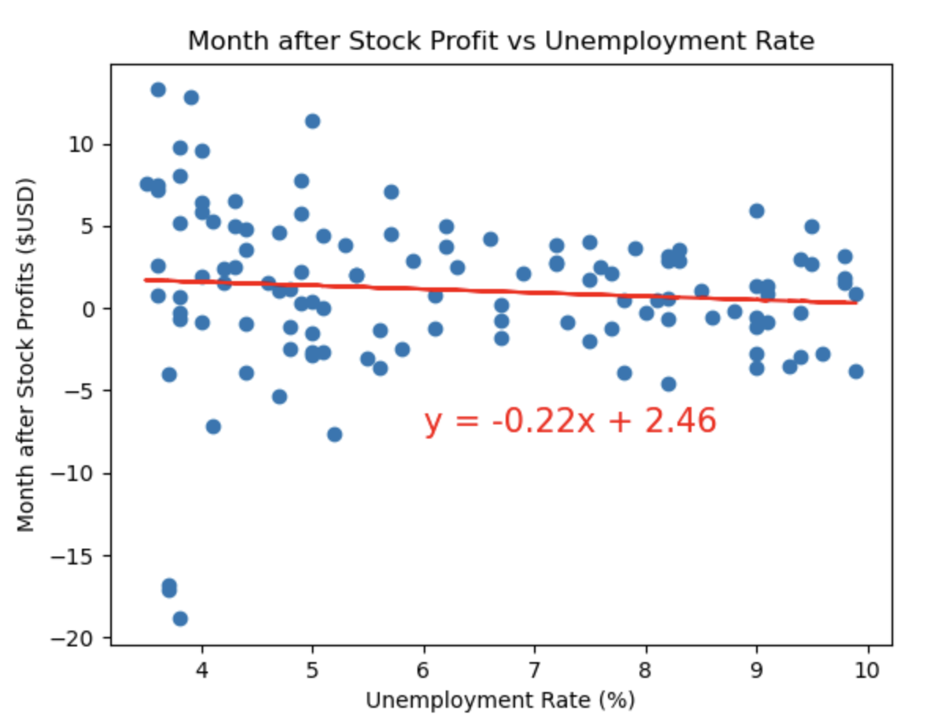
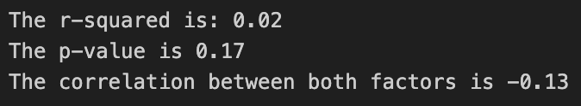
Analysis Approach
Create panda Data Frames, merge data frames
Compare the stock profits/price against macro economic indices using matplotlib
Line Plot
Bar Chart
Scatter plot
Statistical analysis
Line Regression
Pearson Correlation
Notes:
Pearson Corro

Slide 7

Results

Slide 8
Stock Profits vs Month

Slide 9
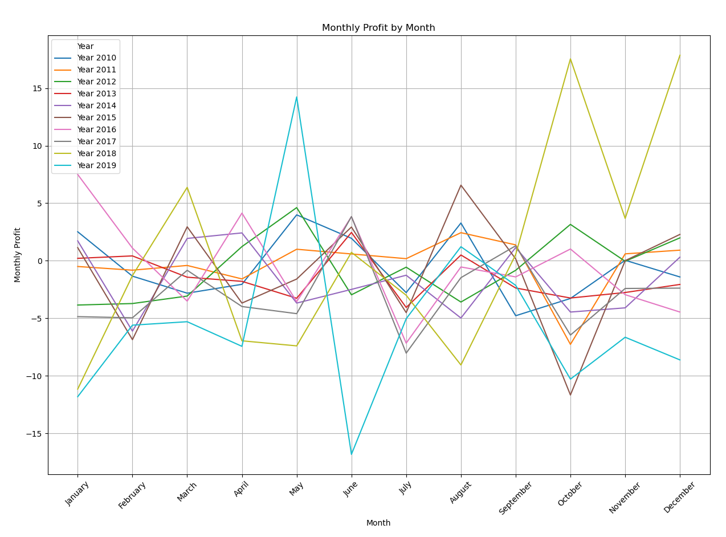
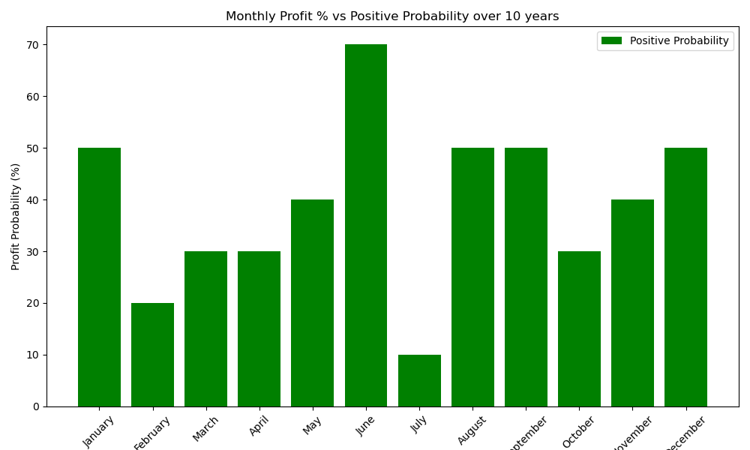
If you buy stock in end of May, the probability of the stock profit at the end of June is around 70%.
Do not trade in Stock in July as this is the worst performing month on average.

Slide 10

Stock Profits vs Unemployment

Slide 11
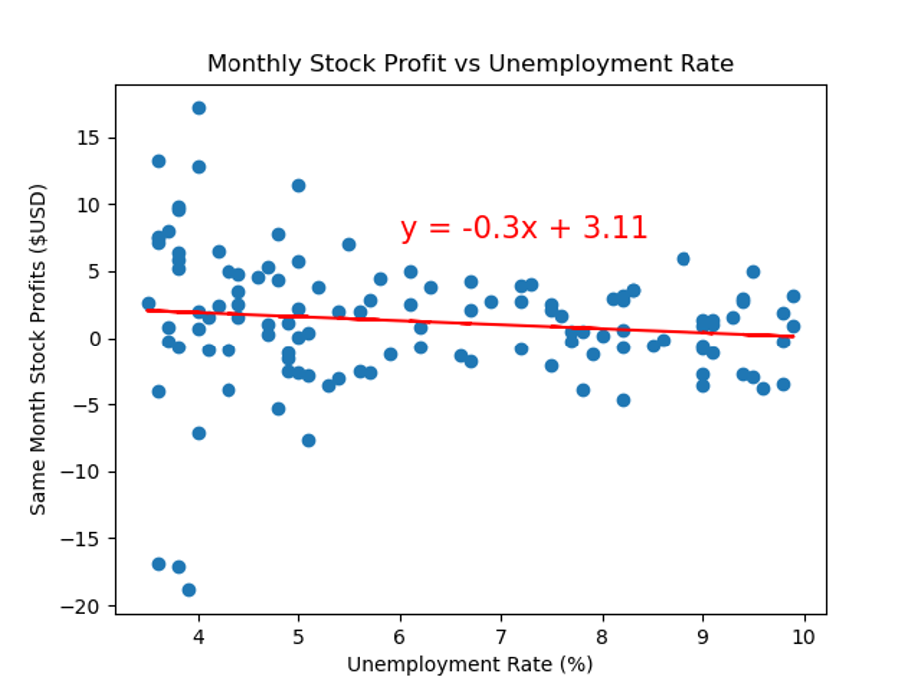
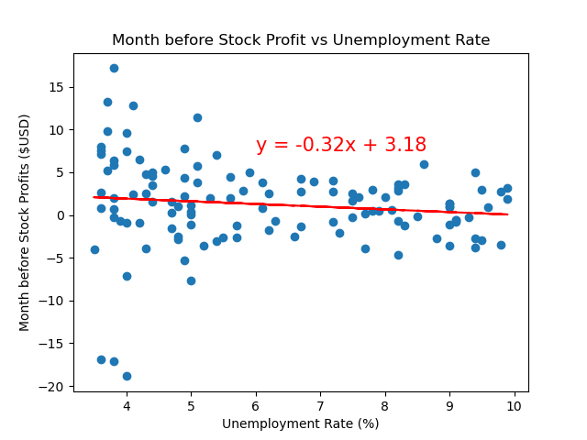
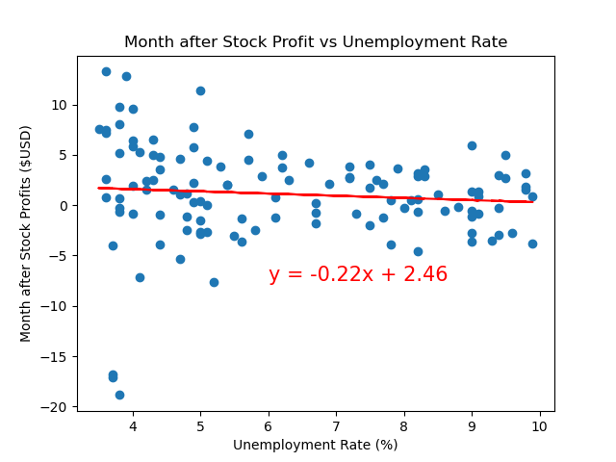
The monthly stock profit does not appear to show any correlation with the unemployment rate.

Slide 12
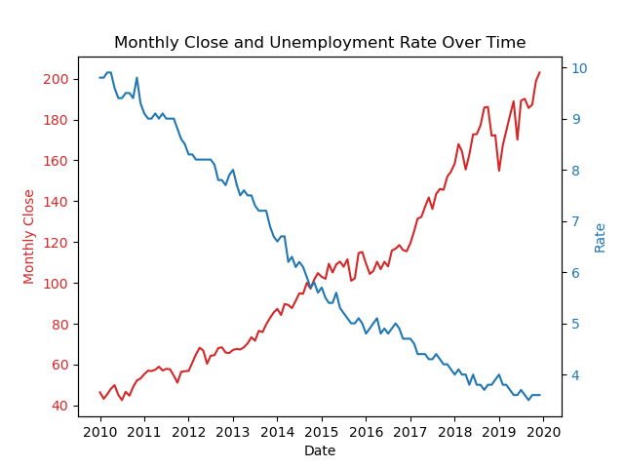
The stock closing price and unemployment rate is showing an opposite trend over time.

Slide 13

Stock Profits vs Interest Rate

Slide 14
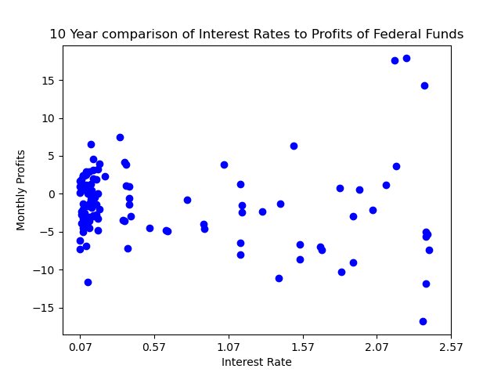
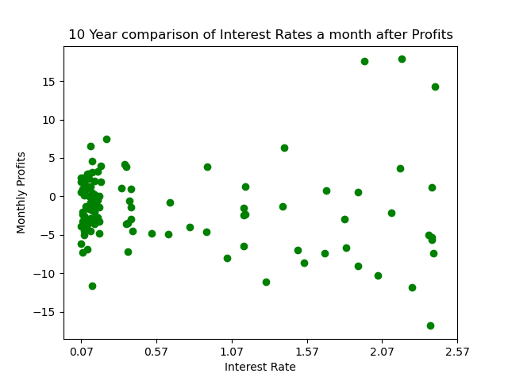
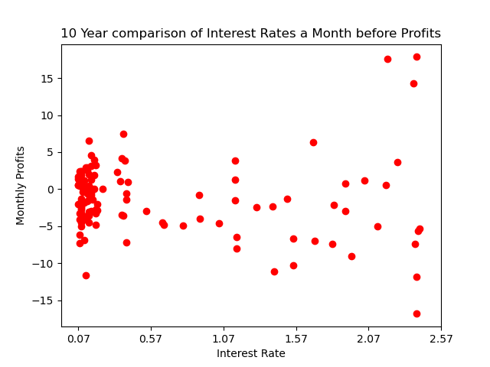
Stock price in 2-years US Treasury Bond Rate is showing similar trend over time. However, there are no correlation between the stock price and the 10-year Treasury Bond Rate.

Slide 15
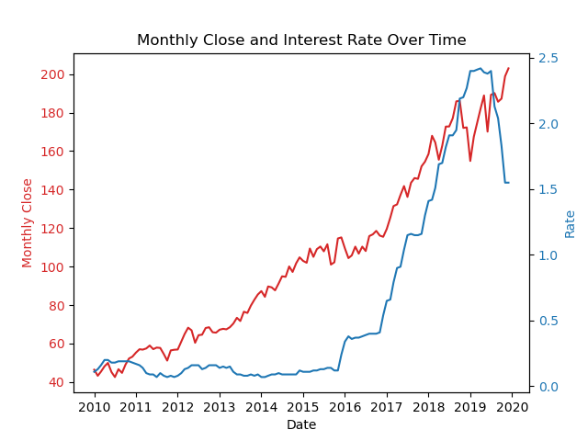

Slide 16
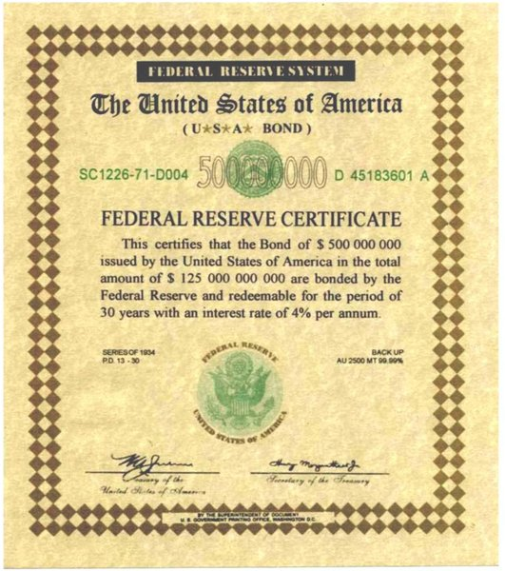
Stock Profits vs US Bond Rate

Slide 17
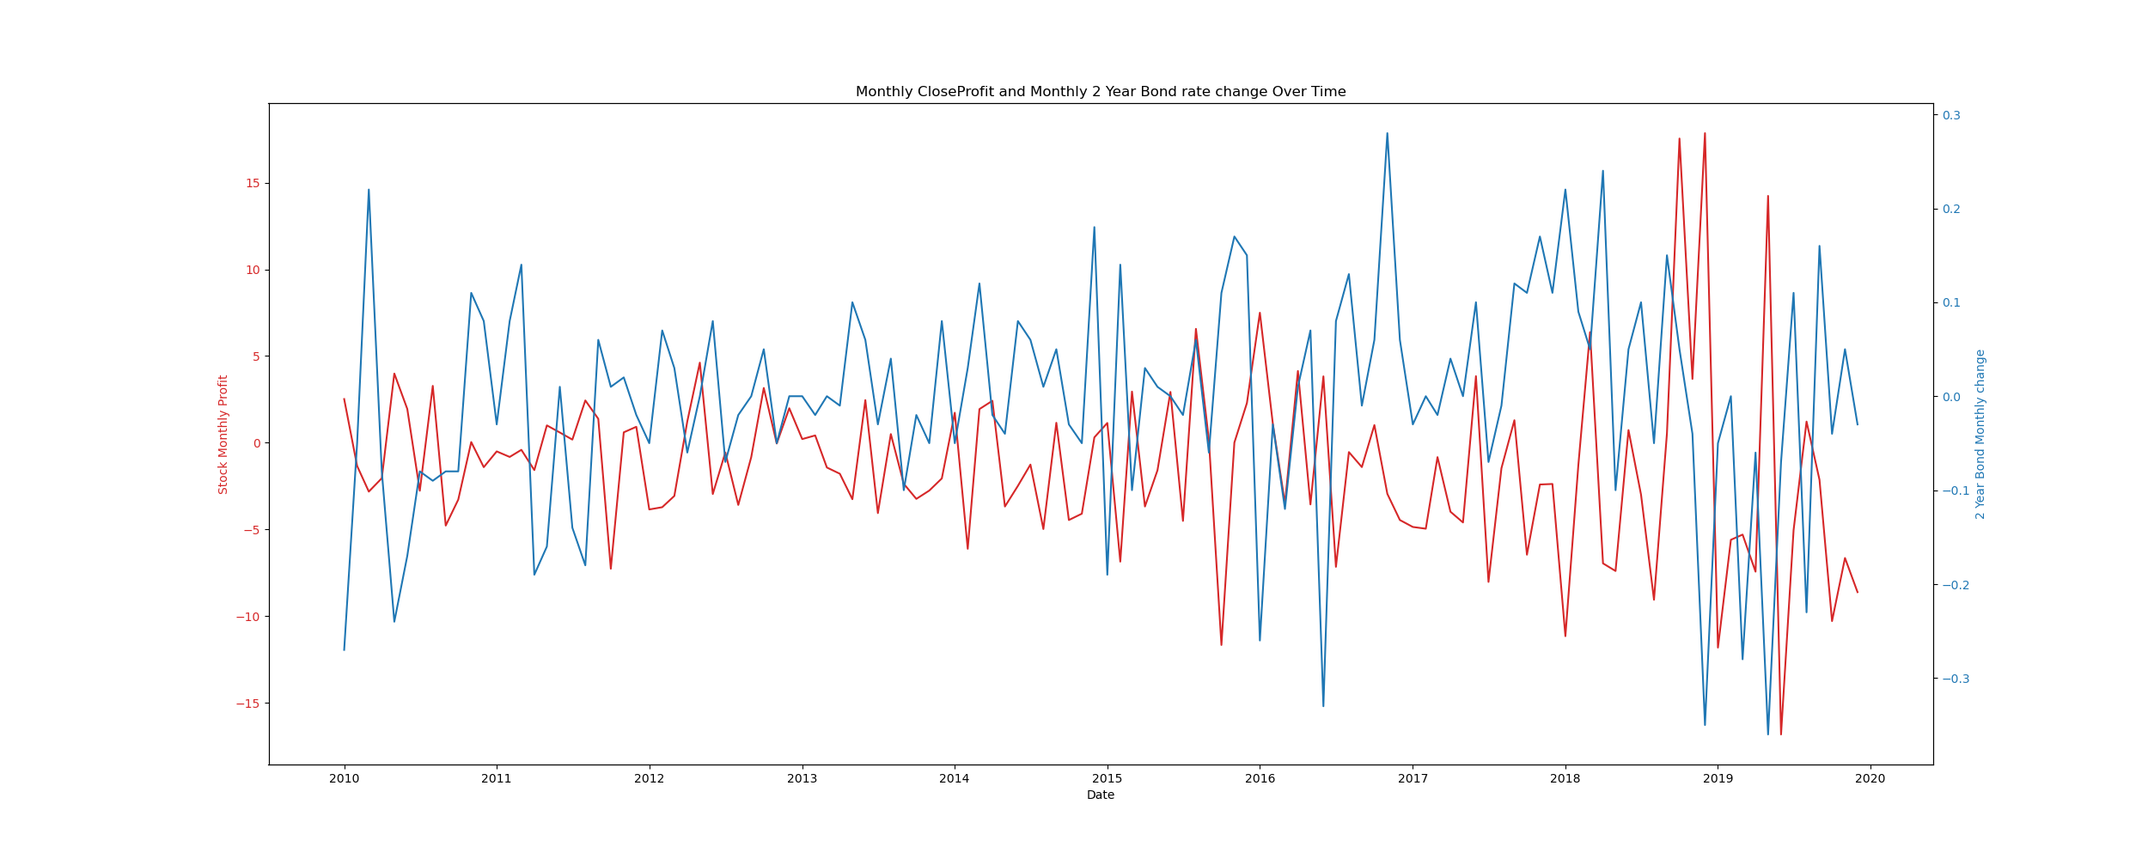
Stock price in 2-years US Treasury Bond Rate is showing similar trend over time.

Slide 18
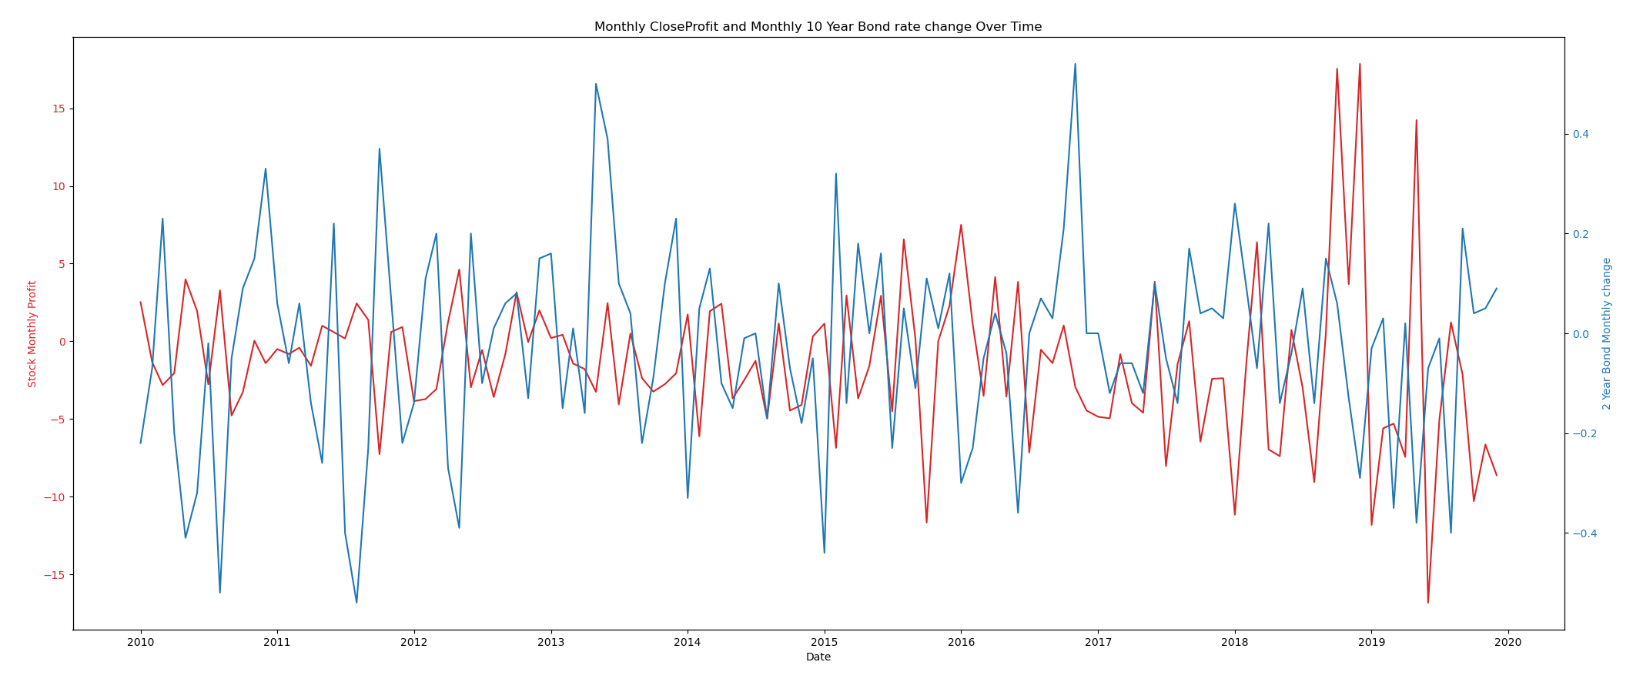

Slide 19
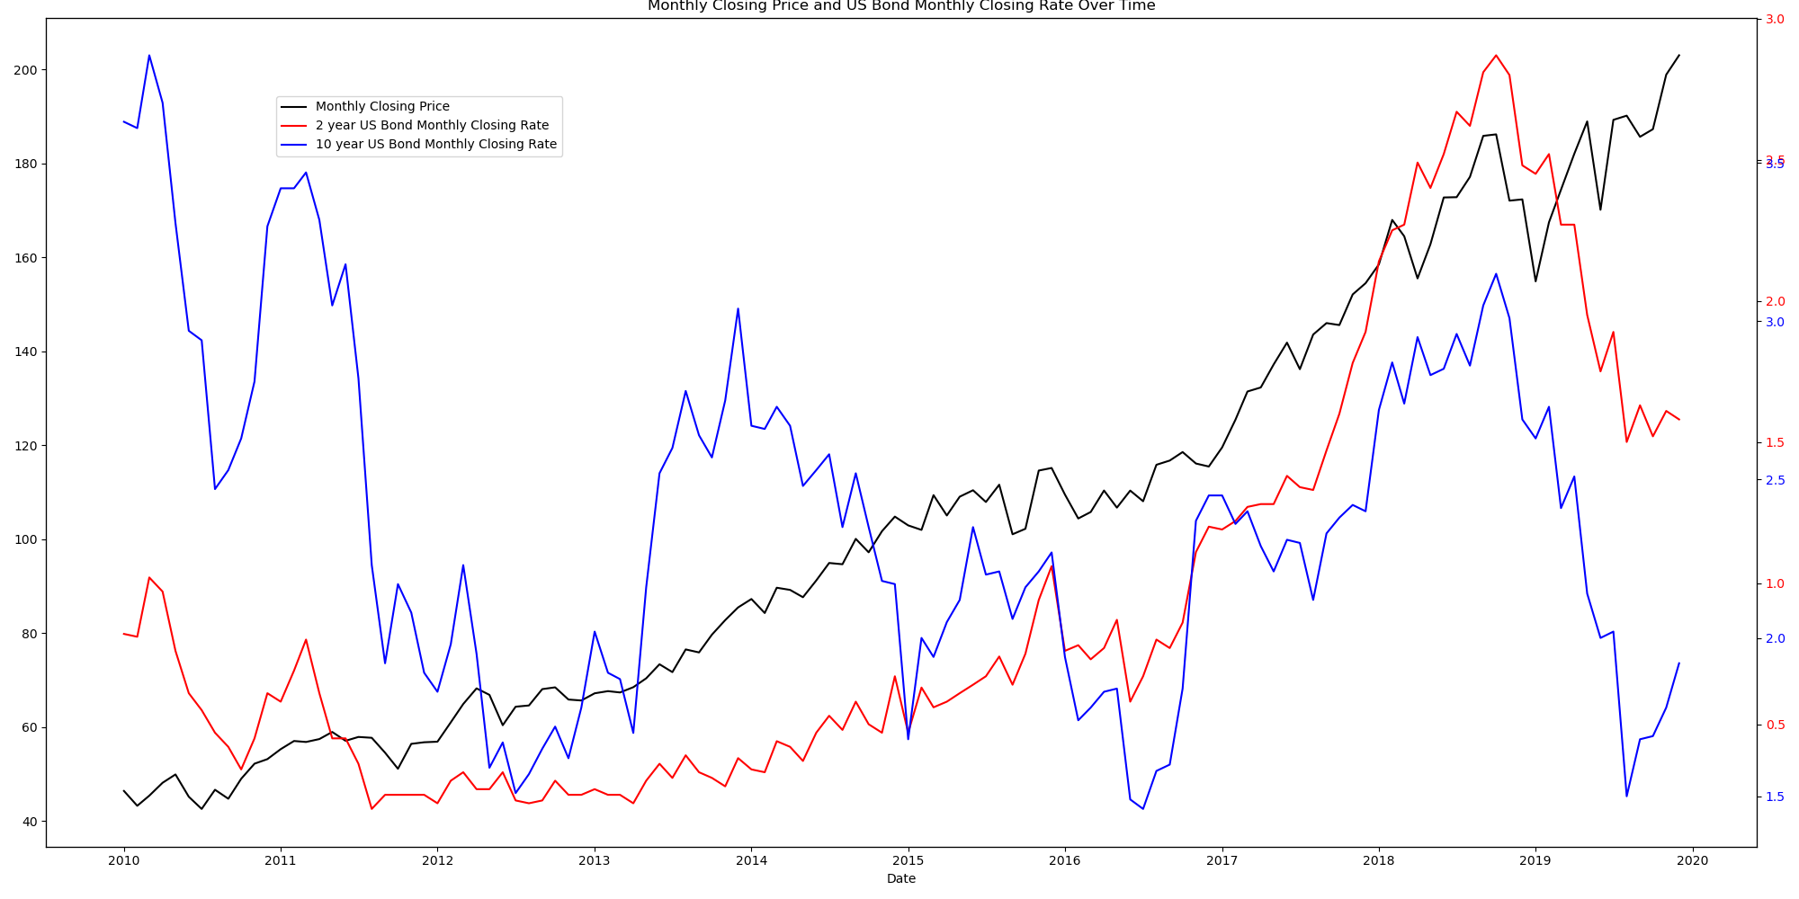
Stock price in 2-years US Treasury Bond Rate is showing similar trend over time. However, there are no correlation between the stock price and the 10-year Treasury Bond Rate.

Slide 20
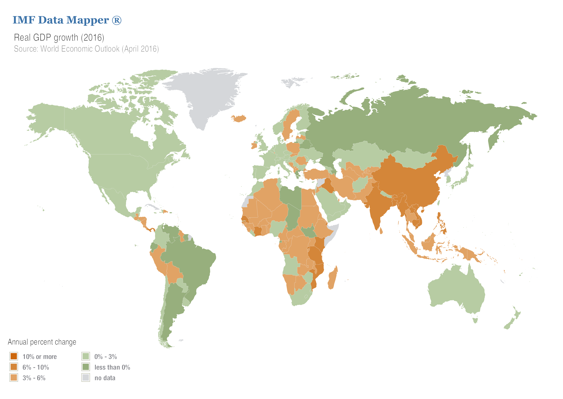
Stock Profits vs Real GDP per Capita

Slide 21
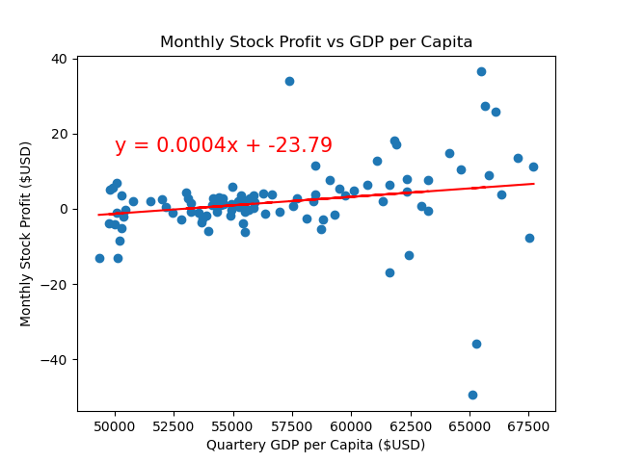
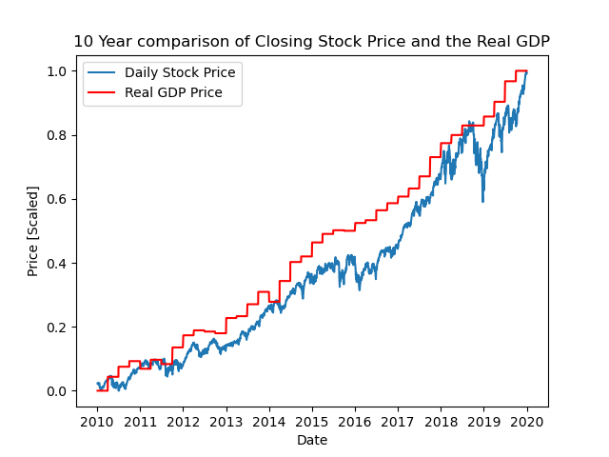
The monthly stock profit does not appear to show any correlation with the Quarterly GDP per Capita.
The closing stock price vs GDP has a correlation value of 0.99.

Slide 22
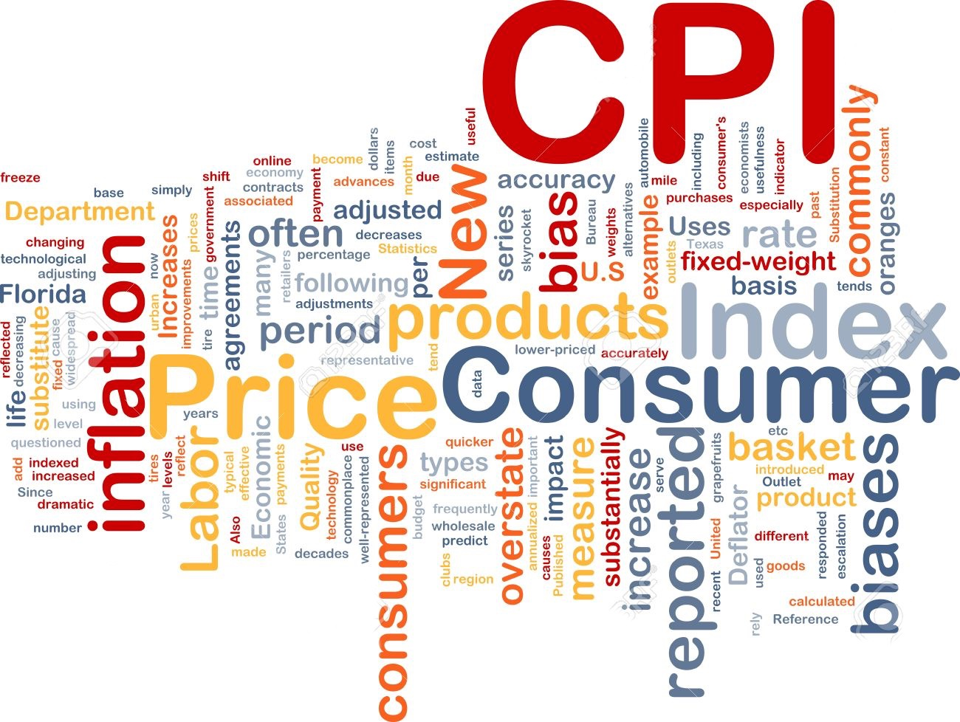
Stock Profits vs US CPI

Slide 23
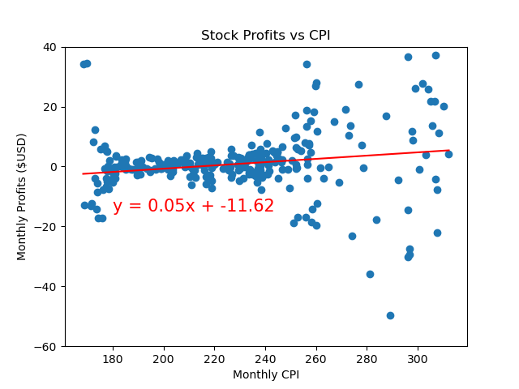
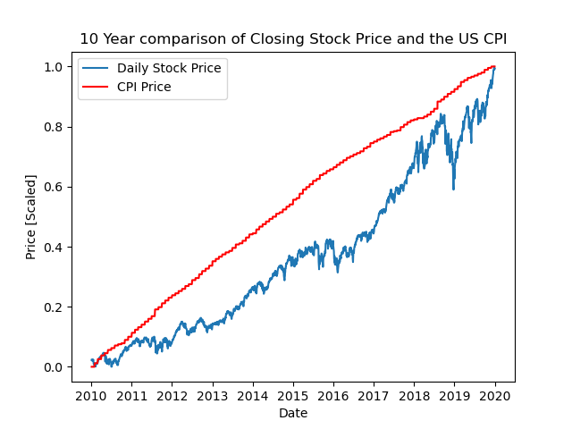
The monthly stock profit does not appear to show any correlation with the CPI.
The closing stock price vs CPI has a correlation value of 0.97.

Slide 24
Next Step
Develop a Machine Learning classification algorithm to plot boundaries to predict future possible outcome:
Kernel Trick SVM
K-Nearest Neighbour model
Naive Bayes model

Slide 25
Thank You

